Slide 1
SIT374/764: Project Management
Lecture 5: Time management (part 2)

Slide 2
Project management process groups
Approved Project Management Plan
Completion Report
Monitoring
Initiation
Planning
Executing
Closing
Control
Approved Project Charter
Customer signoff

Slide 3
Project management process groups-Activity Map
Project Plan
Acquire & manage
team
Monitor &
Control Proj.
Project
Closing
Project Charter
Scope
Time
Cost
Quality
HR
Risk
Procurement
Stakeholders
Comm.
Stakeholders
Register
Scope control &
verification
Select Sellers &
POs
Contract
Closing
Schedule control
Progress Reporting
Perform QA
Manage Stakeholders
Comm.
Contract Admin
Initiation
Planning
Executing
Mon. & Con.
Closing

Slide 4
Processes in Time Management
Define Activities
Sequence
Activities
Resoursing/Estimate Activities Durations
Develop Schedule
Control
the Schedule
Plan schedule management
Monitoring and
Controlling
Planning

Slide 5
5. Develop schedule
Previous projects are good references!
Determine the start and end dates of the project. Uses several iterations.
Always create a realistic schedule
The first tool for monitoring progress
Consequences of unrealistic schedule is BIG!
Many different tools
Network diagram
Gantt charts
Critical path analysis
Critical chain scheduling
PERT analysis

Slide 6
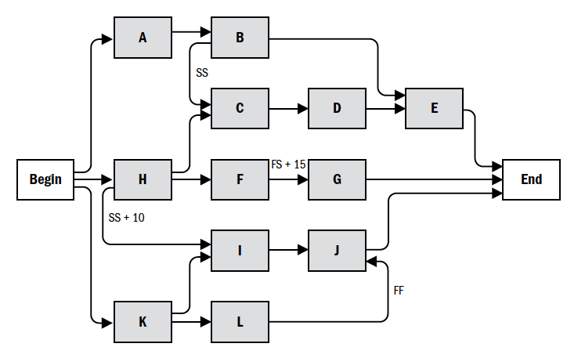
Precedence diagramming
Any type of dependencies, leads/lags can be presented through PDM

Slide 7
Gantt chart
Provides standard format of displaying project schedule information by listing project activities and their corresponding start and finish dates in calendar format
Activities on the Gantt Chart must coincide with the activity list and the milestone list
Gantt Chart contains milestones, summary tasks, individual task duration, and arrows showing task dependencies
You can create Milestones by creating a task (duration will be zero) and making it as milestone In MS Project

Slide 8
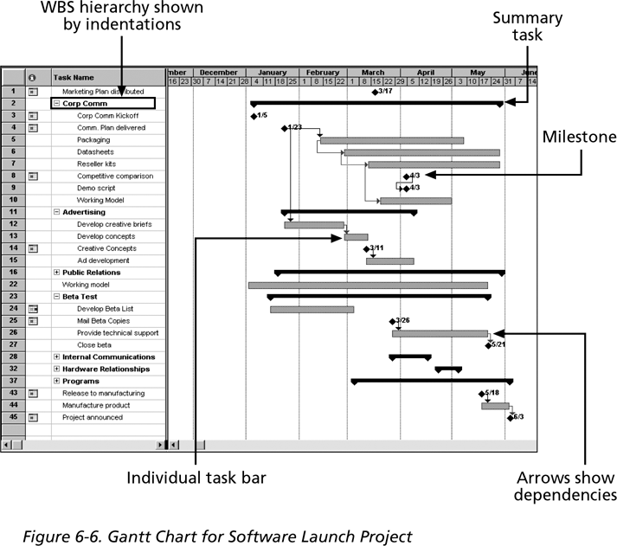
Gantt chart (cont’d)

Slide 9
Schedule and schedule baseline
Flexibility vs. Stability: The project schedule is flexible and subject to regular updates and changes as the project progresses, whereas the schedule baseline is stable and changes only through formal revision and approval processes.
Purpose: The project schedule is used for guiding project activities. The schedule baseline is used as a benchmark for evaluating project performance.
Change Management: Changes to the project schedule can be made relatively easily by the project manager or the project team as part of ongoing project management. In contrast, changes to the schedule baseline require formal change control procedures.

Slide 10
Critical path analysis…

Slide 11
Critical path analysis
Technique to predict total project duration
A critical path is series of activities that determines the earliest project completion time
Is the longest path in a network diagram
Has the least amount of slack or float
Slack (or float) is the amount of time an activity can be delayed without delaying
a succeeding activity
the project finish date

Slide 12
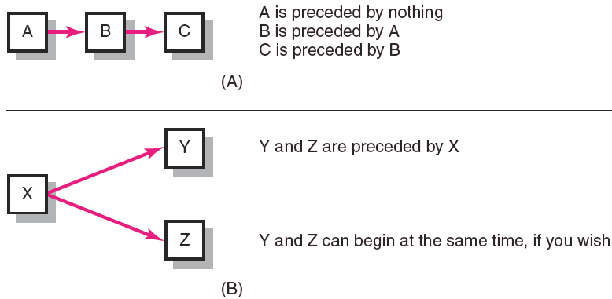
Activity-on-Node Fundamentals
FIGURE 6.2

Slide 13
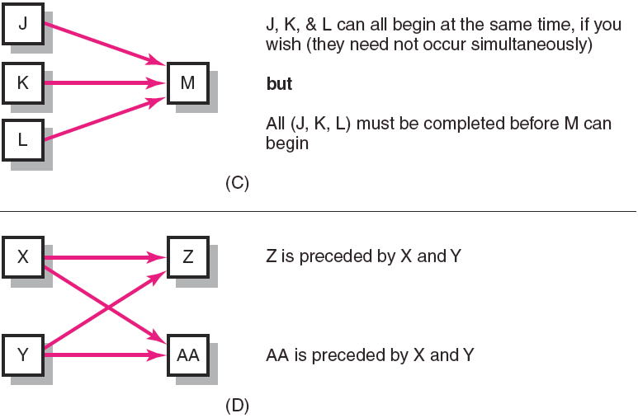
Activity-on-Node Fundamentals (cont’d)
FIGURE 6.2 (cont’d)

Slide 14
Critical Path Analysis
As the network diagram in most scenarios in project management is essentially a directed, and acyclic graph, topological sort method can be used to solve it in linear time.
Software should have incorporated functionality to enable the calculation of critical path.
For small-scale networks, it can be calculated/observed by determining the slack values.
Slack values can be computed based on ES, LS, EF, LF.
ES: Early Start
EF: Early Finish
LS: Latest Start
LF: Latest Finish
ES | Task | EF
LS |  | LF

Slide 15
Early start/finish
Early Start Date: for an activity is the earliest possible time an activity can start based on the project network logic.
Early Finish Date: for an activity is the earliest possible time an activity can be finished based on the project network logic.
Forward Pass: determines the early start date and early finish date for an activity.
The Project Start Date is equal to the early start date of the first activity on the network diagram.
Early start plus the duration of the activity is equal to the early finish date of the activity.
It is also equal to the early start date of the subsequent activity unless an activity has multiple predecessors.

Slide 16
Free/total slack
Free Slack: is the amount of time an activity can be delayed without delaying the early start of any immediately following activity.
Total Slack: is the amount of time an activity can be delayed from its early start date without delaying the planned project finish date
The project manager can calculate the free slack and total slack by using forward and backward pass through the network diagram

Slide 17
Late start/finish
Late Finish Date: latest date that a task must finish without affecting the completion date.
Late Start Date: latest date that a task can start without causing a delay for the entire project completion.
Backward Pass: determines the late start date and late finish date for an activity.
The Project End Date is equal to the early/late finish date of the last activity on the network diagram.
Late start plus the duration of the activity is equal to the late finish date of the activity.

Slide 18
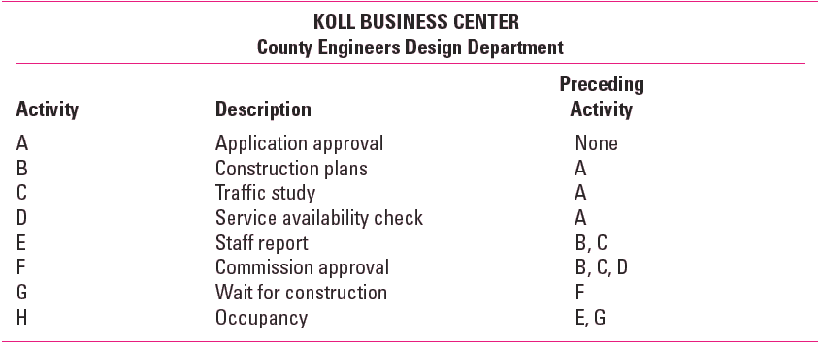
Network Information
TABLE 6.1

Slide 19
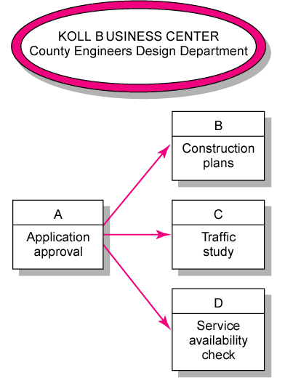
Koll Business Center—Partial Network
FIGURE 6.3

Slide 20
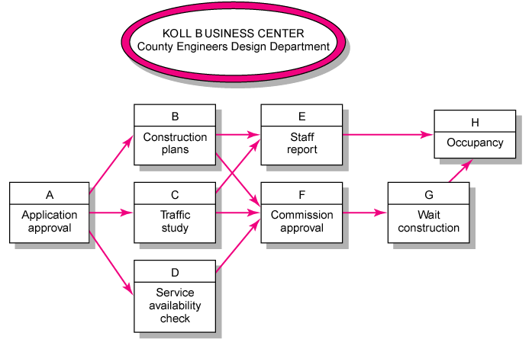
Koll Business Center—Complete Network
FIGURE 6.4

Slide 21
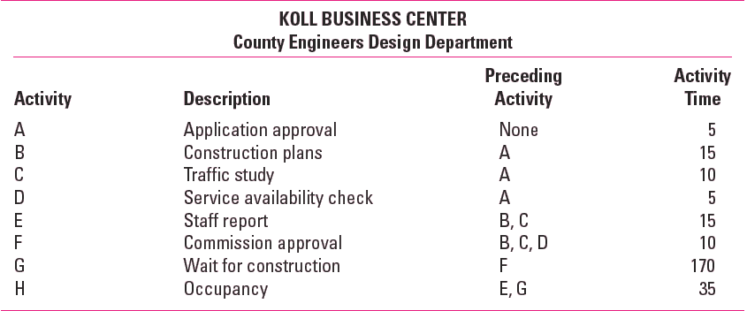
Network Information
TABLE 6.2

Slide 22
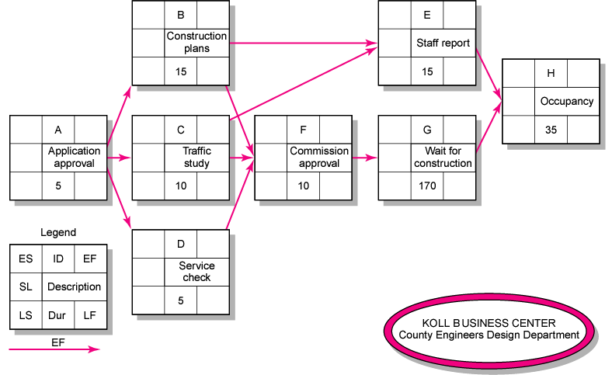
Activity-on-Node Network
FIGURE 6.5

Slide 23
Forward Pass Computation
Add activity times along each path in the network (ES + Duration = EF).
Carry the early finish (EF) to the next activity where it becomes its early start (ES) unless…
The next succeeding activity is a merge activity, in which case the largest EF of all preceding activities is selected.

Slide 24
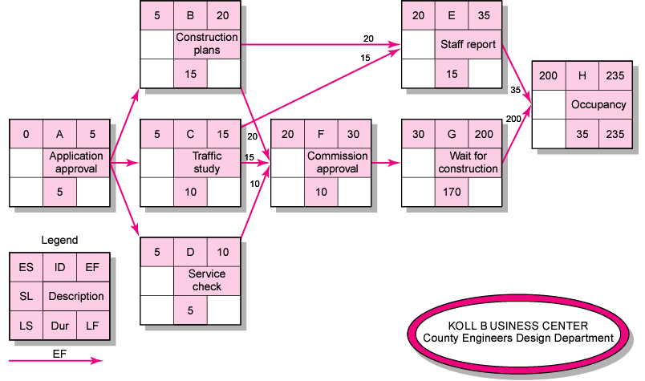
Activity-on-Node Network Forward Pass
FIGURE 6.6

Slide 25
Backward Pass Computation
Subtract activity times along each path in the network (LF - Duration = LS).
Carry the late start (LS) to the next activity where it becomes its late finish (LF) unless
The next succeeding activity is a burst activity, in which case the smallest LF of all preceding activities is selected.

Slide 26
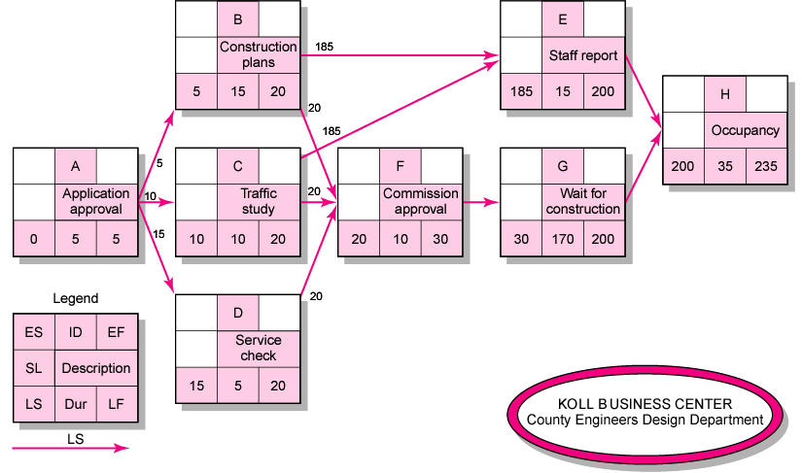
Activity-on-Node Network Backward Pass
FIGURE 6.7

Slide 27
Determining Slack (or Float)
Slack (or Float)
The amount of time an activity can be delayed after the start of a longer parallel activity or activities.
Total slack
The amount of time an activity can be delayed without delaying the entire project.
The critical path is the network path(s) that has (have) the least slack in common.

Slide 28
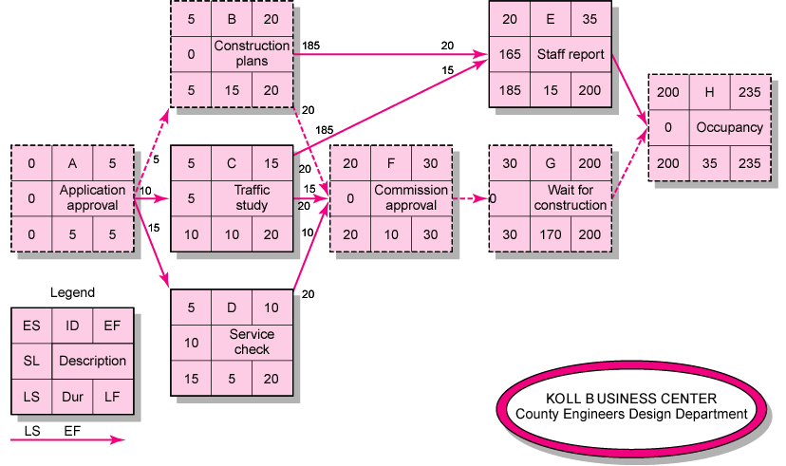
Activity-on-Node Network with Slack
FIGURE 6.8

Slide 29
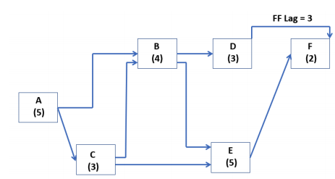
Activity 1: What if other dependencies exist?

Slide 30
Steps For Critical Path Analysis
Activity specification
Activity sequence establishment
Network diagram
Estimates for each activity
ES, EF, LS, LF through forward/backward pass
Slack based on ES, EF, LS, LF
Path identification

Slide 31
Using the Critical Path to Shorten a Project Schedule
Main techniques for shortening schedules
Crashing activities by obtaining the greatest amount of schedule compression for the least incremental cost
Shortening durations of critical activities/tasks by adding more resources or changing their scope
Fast tracking activities to enable activities normally done in sequence to overlap

Slide 32
Importance of Updating Critical Path Data
It is important to update project schedule information to meet time goals for a project
The critical path may change as you enter actual start and finish dates
If you know the project completion date will slip, be proactive and negotiate with the project sponsor and stakeholders

Slide 33
PERT
PERT is a network analysis technique to estimate project duration
Good when there is a high degree of uncertainty in activity duration
Uses probabilistic time estimates
Remember the three-point estimate?
Calculate PERT duration by averaging the total of
1x Optimistic time
4x most likely time
1x Pessimistic time
PERT Weighted average: (Optimistic time + 4* most likely time + pessimistic time) / 6

Slide 34
Activity 2
You are managing a software upgrade project, which includes several tasks with specific dependencies. The team has provided optimistic (O), most likely (M), and pessimistic (P) time estimates for each task in days. You need to apply PERT analysis to calculate the expected durations and use the CPM to identify the critical path.
Here are the tasks with their dependencies and time estimates:
Task A (Start): No dependencies. O: 2 days, M: 4 days, P: 6 days
Task B: Directly depends on the completion of Task A. O: 5 days, M: 7 days, P: 11 days
Task C: Also directly depends on the completion of Task A. O: 3 days, M: 5 days, P: 8 days
Task D: Begins only after both Task B and Task C are completed. O: 6 days, M: 8 days, P: 14 days
Task E: Starts immediately after Task D is completed. O: 4 days, M: 6 days, P: 10 days
Task F: Can start once Task C is completed (does not depend on Task B or D). O: 2 days, M: 3 days, P: 5 days
Task G (End): Commences only after both Task E and Task F are completed. O: 3 days, M: 5 days, P: 9 days
Using the above information:
a. Use the PERT formula to calculate the expected duration for each task. b. Construct a project network diagram, showing the dependencies and identifying all possible paths from the start to the end of the project. c. Determine the expected duration of each path to identify the critical path with the longest duration.

Slide 35
Control schedule
Controlling schedule is the process of monitoring project status to update project schedule and managing changes to the schedule baseline.
The main outputs include:
Project document/plan updates
Change requests
Work performance measurements (compared to schedule baseline)
We will learn several performance indicators in the next session.

Slide 36
Summary
Scheduling
Critical path analysis/PERT analysis
ES, EF, LS, LF
Slack
Forward/backward pass
Control schedule

Slide 37
What’s next
Next area of project management – cost management

